Slide 1
EENG 284 Lab 7
Cellular Automata
Notes:
Usually the <title of the lab> is what will be called the “System” through the rest of this document

Slide 2
Lab Objectives
Logic
Simple FSM
Cellular automata
Verilog
D flip flop
Simulation
Synthesis

Slide 3
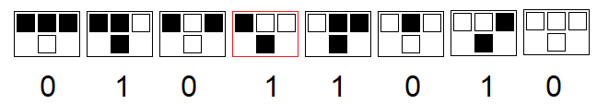
Theory
Collection of basic processing elements
Two states, alive (filled = black = 1) and dead (empty = white = 0)
Models population dynamics
Next state depends on current state and two nearest neighbors states
Apply rule to each cell to determine next state
Notes:
Replace <System> with the name of the

Slide 4
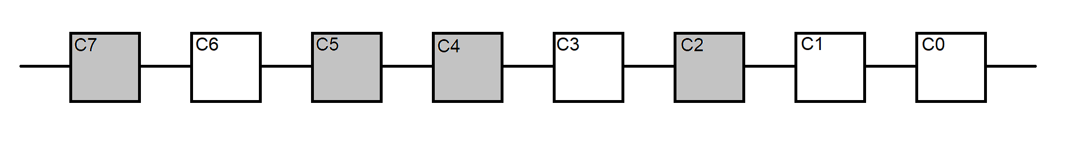
Theory
Rules are numbered by the binary code of the next state
For example: 8’b01011010 = Rule 90
What is next state of cells under Rule 90?
Assume that C7 left connects with C0 right
Notes:
Replace <System> with the name of the

Slide 5
Theory
What is next state of cells under Rule 90?
Assume that C7 left connects with C0 right
C7 | C6 | C5 | C4 | C3 | C2 | C1 | C0
010 | 101 | 011 | 110 | 101 | 010 | 100 | 001
0 | 0 | 1 | 1 | 0 | 0 | 1 | 1
Notes:
Replace <System> with the name of the

Slide 6
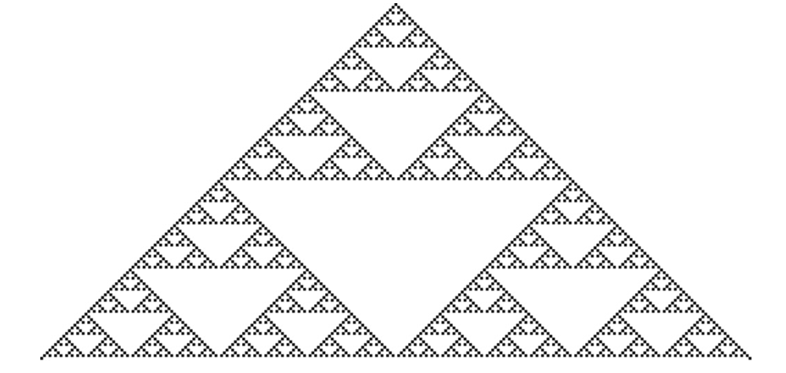
Theory
Rule 90 from a single cell
Notes:
Replace <System> with the name of the

Slide 7
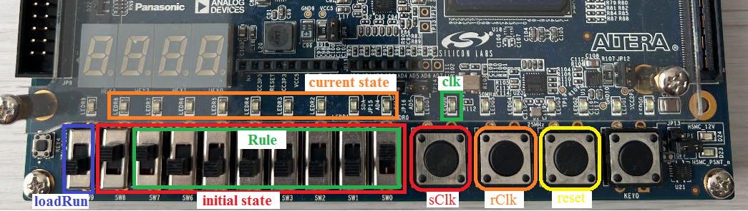
Operation
Notes:
Talk about the input is transformed into the output using the system architecture

Slide 8
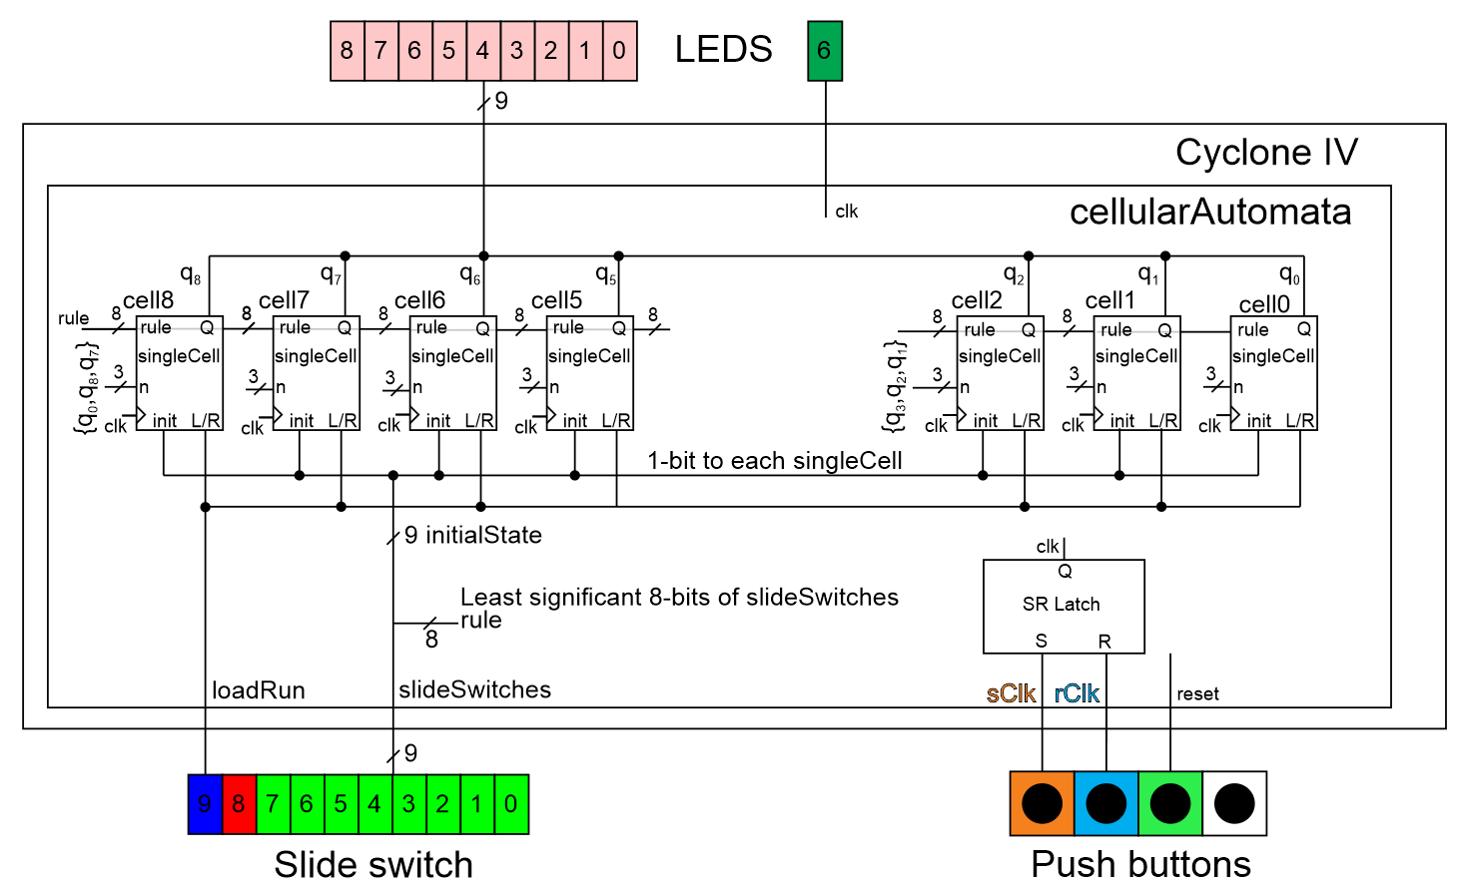
System Architecture

Slide 9
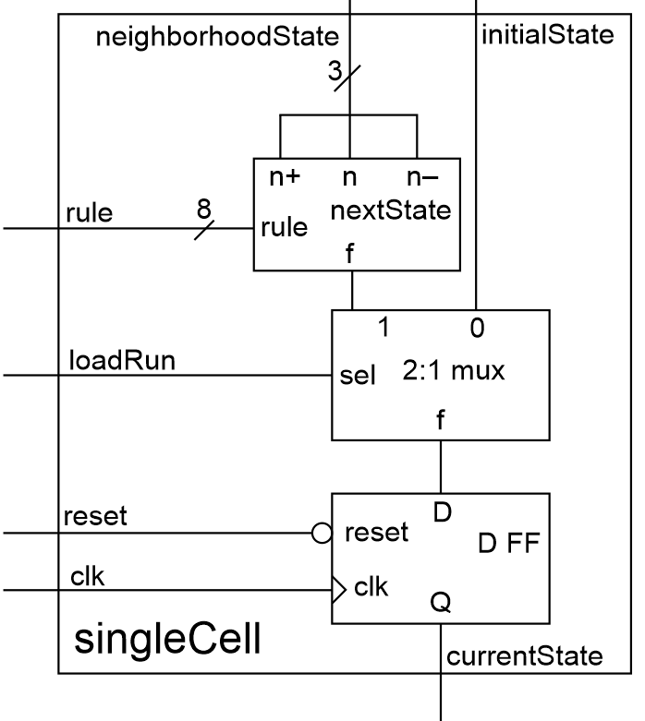
singleCell module

Slide 10
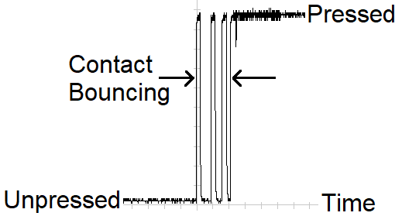
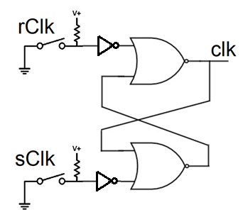
Switch Bouncing
Contacts of a switch physically bounce
Solution is to use SR latch
sClk button to set input
rClk button to reset input
If sClk bounces, just sets already set
If rClk bounces, just resets already reset
Two button presses for 1 clk period

Slide 11
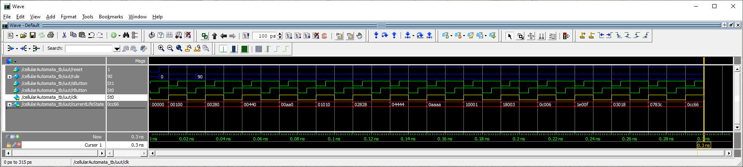
Deliverables
cellularAutomata Testbench (Rule 90 from a single cell)
Working cellularAutomata implementation on Cyclone V GX

